Slide 1

Customer Shopping Behavior Analysis
Analyzing 3,900 purchases to uncover insights into spending patterns, customer segments, product preferences, and subscription behavior to guide strategic business decisions.

Slide 2

Dataset Overview: Key Features
Customer Demographics
Purchase Details
Shopping Behavior
Age, Gender, Location, and Subscription Status.
Item Purchased, Category, Amount, Season, Size, and Color.
Discount Applied, Promo Code Used, Previous Purchases, Frequency, Review Rating, and Shipping Type.
The dataset contains 3,900 rows and 18 columns, with 37 missing values in the Review Rating column.

Slide 3


Exploratory Data Analysis (EDA) in Python
Data Cleaning & Imputation
Data Loading & Exploration
Handled missing data by imputing null values in Review Rating using the median rating of each product category.
Imported data using pandas; checked structure with df.info() and summary statistics with .describe().
Database Integration
Standardization & Engineering
Loaded the cleaned DataFrame into a PostgreSQL database for structured SQL analysis.
Renamed columns to snake case. Created age_group and purchase_frequency_days features. Dropped redundant promo_code_used.

Slide 4
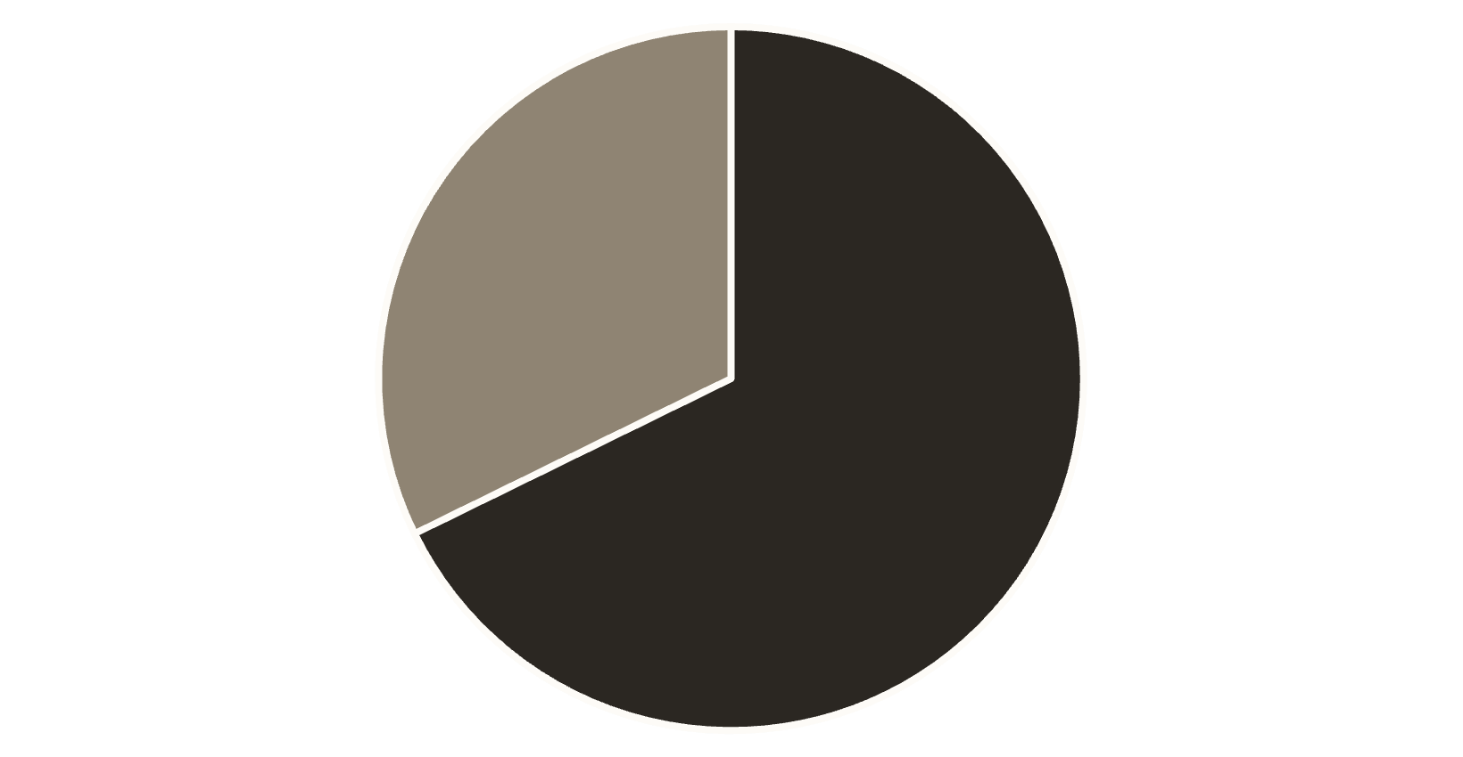
Revenue Comparison by Gender
Male Customers Drive Higher Revenue
Total revenue generated by male customers is more than double that of female customers, indicating a significant difference in spending volume.
Male Revenue: $157,890
Female Revenue: $75,191
Male
Female

Slide 5

Key Findings: Spending & Shipping
839
$60.48
$58.46
High-Spending Discount Users
Express Shipping Average Spend
Standard Shipping Average Spend
Number of customers who used a discount but still spent above the average purchase amount.
Average purchase amount for customers using Express Shipping.
Average purchase amount for customers using Standard Shipping.

Slide 6

Subscription Status and Spending
Non-Subscribers
Subscribers
Total Customers: 2,847
Total Customers: 1,053
Avg. Spend: $59.87
Avg. Spend: $59.49
Total Revenue: $170,436
Total Revenue: $62,645
Non-subscribers account for the majority of customers and total revenue, but the average spend is nearly identical across both groups.

Slide 7

Top Products by Rating and Discount Dependency
Top 5 Products by Average Rating
Top 5 Discount-Dependent Products
Gloves (3.86)
Products with the highest percentage of discounted purchases:
Sandals (3.84)
Boots (3.82)
Hat (3.80)
Hat (50.00%)
Skirt (3.78)
Sneakers (49.66%)
Coat (49.07%)
Sweater (48.17%)
Pants (47.37%)

Slide 8
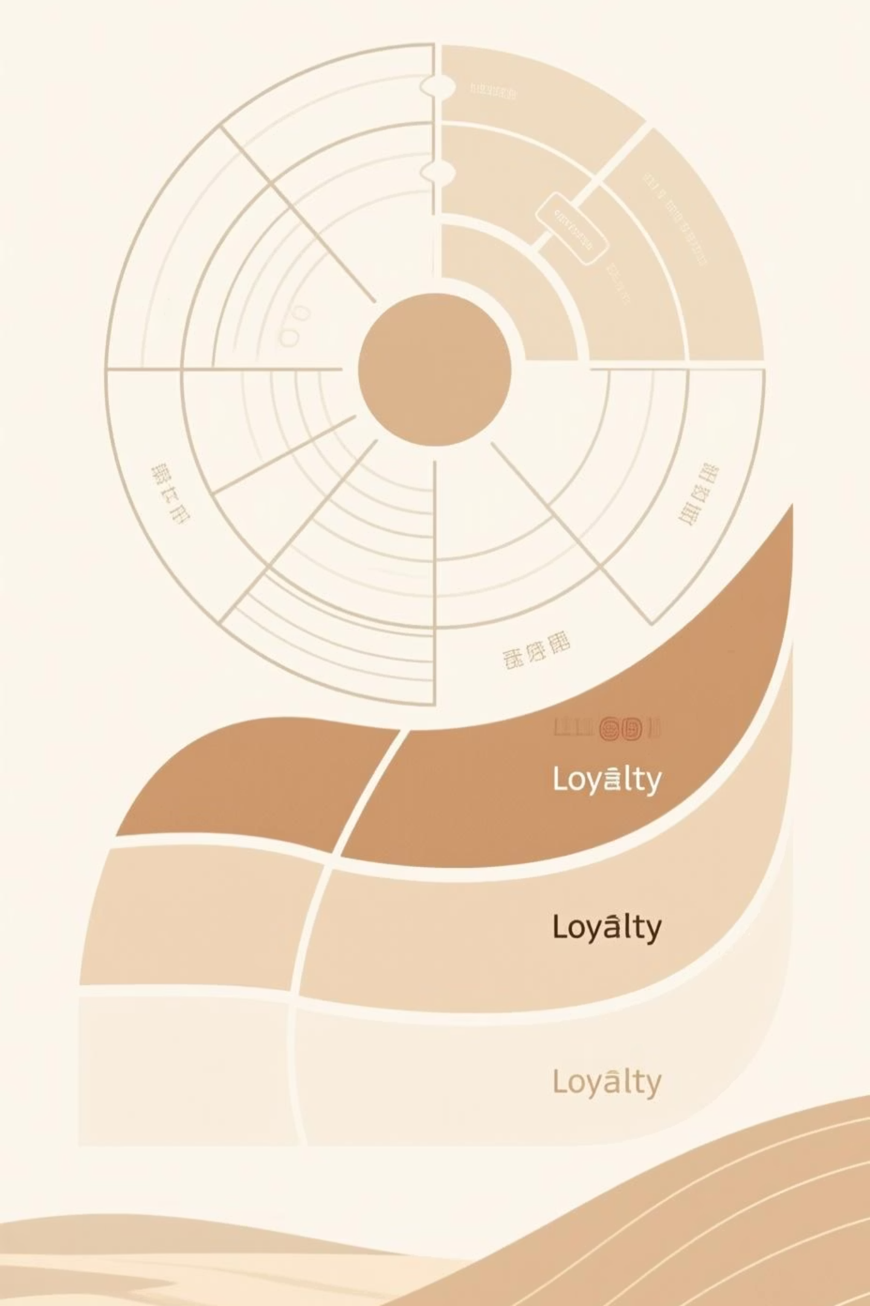
Customer Segmentation & Loyalty
Loyal Customers
Returning Customers
3,116 Customers
701 Customers
New Customers
83 Customers
Repeat Buyers with >5 purchases are more likely to subscribe: 958 repeat buyers are subscribers vs. 2,518 who are not.

Slide 9
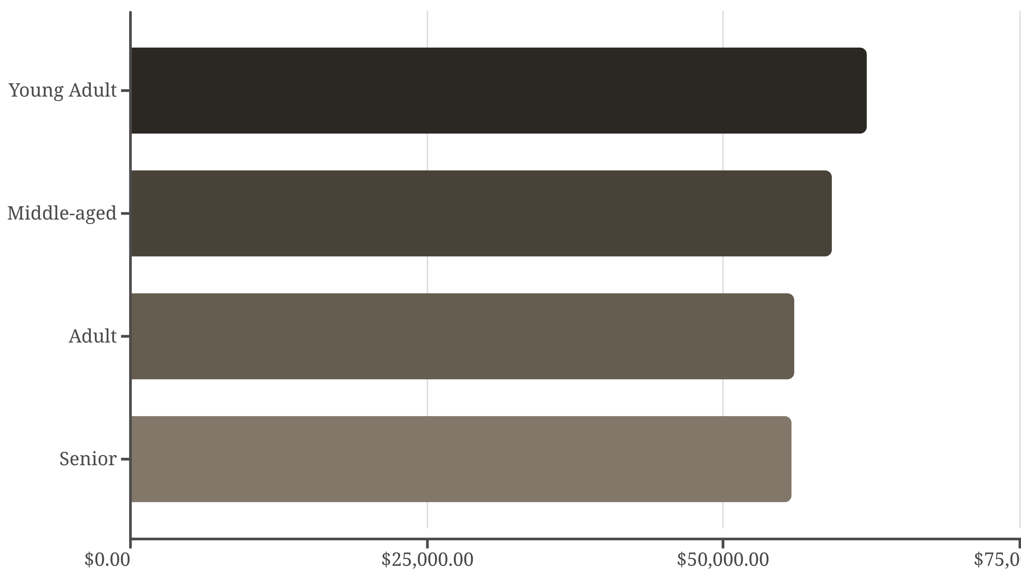
Revenue Contribution by Age Group
Young Adults generate the highest total revenue, followed closely by Middle-aged customers. Revenue contribution is relatively balanced across all groups.

Slide 10
Strategic Business Recommendations
Boost Subscriptions
Promote exclusive benefits to increase subscriber base and revenue.
Customer Loyalty Programs
Reward repeat buyers to transition them into the high-value "Loyal" segment.
Review Discount Policy
Balance sales boosts with margin control, especially for discount-dependent products.
Targeted Marketing
Focus campaigns on high-revenue age groups and express-shipping users for maximum impact.

